Slide 1
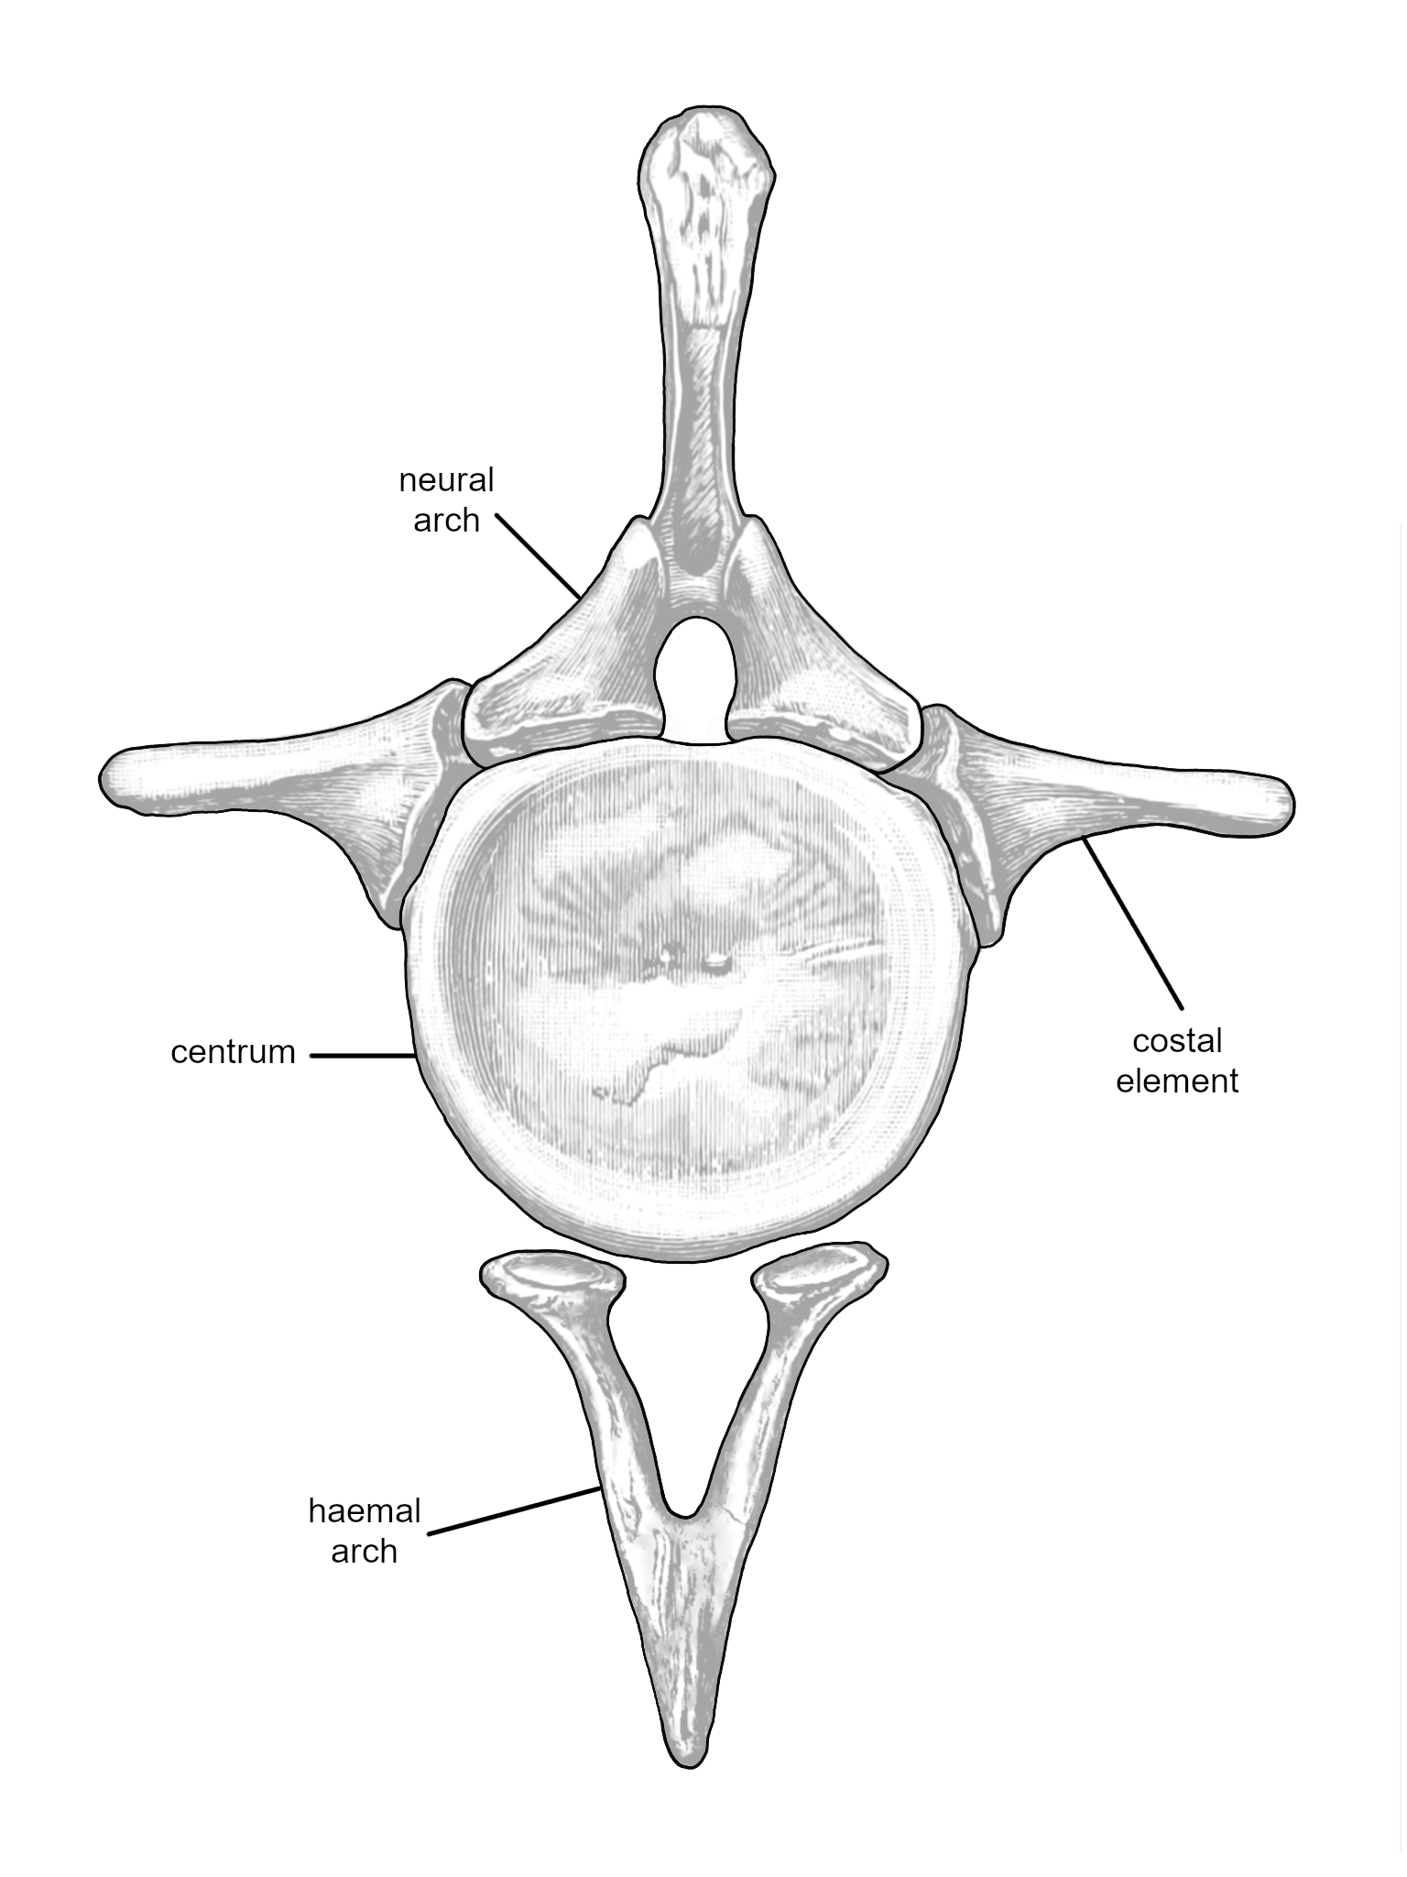
Sites of vertebral pneumatization
Mathew J. Wedel
Western University
of Health Sciences,
Pomona, United States
Michael P. Taylor
Department of Earth Sciences
University of Bristol
United Kingdom
Virtually all tetrapod vertebrae are composed of the same elements: the centrum, neural arch, haemal arch, and paired costal elements. Not all elements are present in all vertebrae, and the costal elements may be fused or mobile, but this is the general plan..
Caudal vertebra 2 of Camarasaurus lentus in anterior view. Modified from Marsh 1896: plate 34, part 4.
Chevron of Camarasaurus grandis in posterior view. Modified from Marsh 1896: plate 39: part 3c.

Slide 2
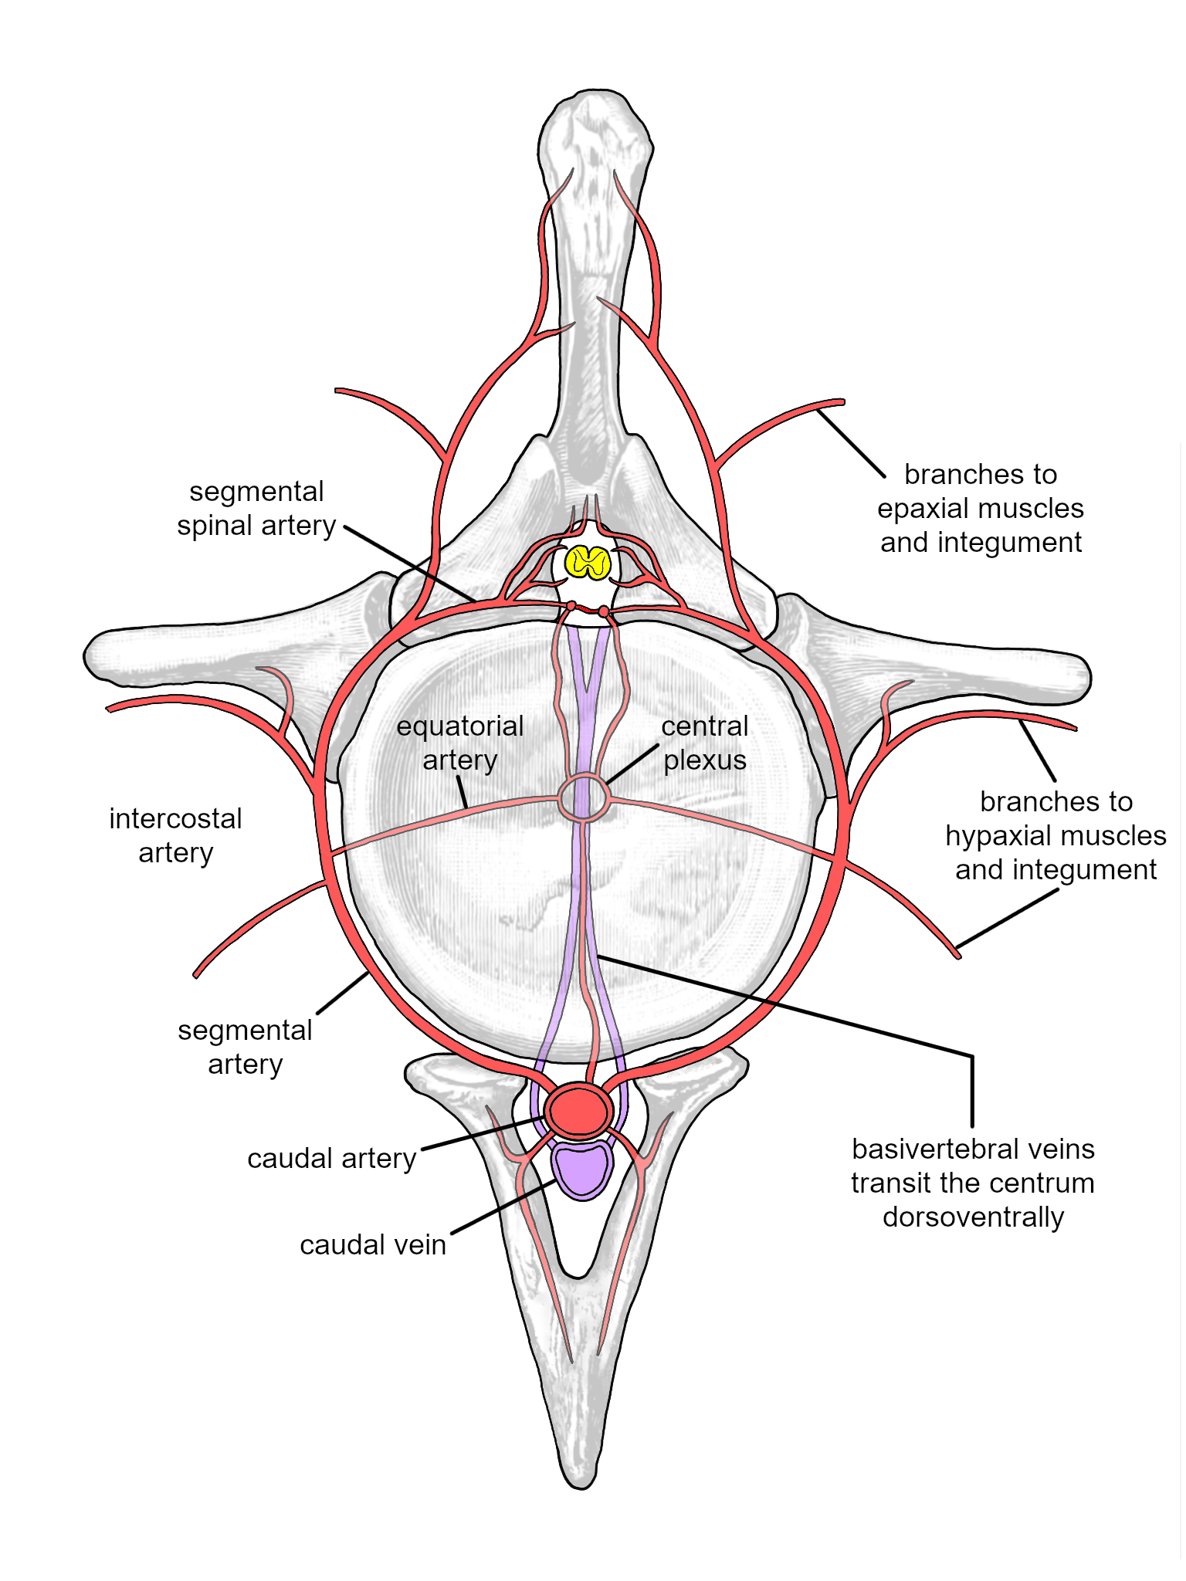
Vascularization (arteries/veins)
These vertebral elements are served by a system of arteries (red) and veins (purple). Specific branching patterns are variable among individuals and lineages, but the basic plan is highly conserved.
See: Amato et al 1959 J Bone Joint Surg 41:782; Crock 1960 J Anat 94: 88; Smuts 1975 Anat Hist Embr 4: 24; Ratcliffe 1982 J Anat 134: 373; Travan et al 2015 Anat Sci Int 90: 308

Slide 3
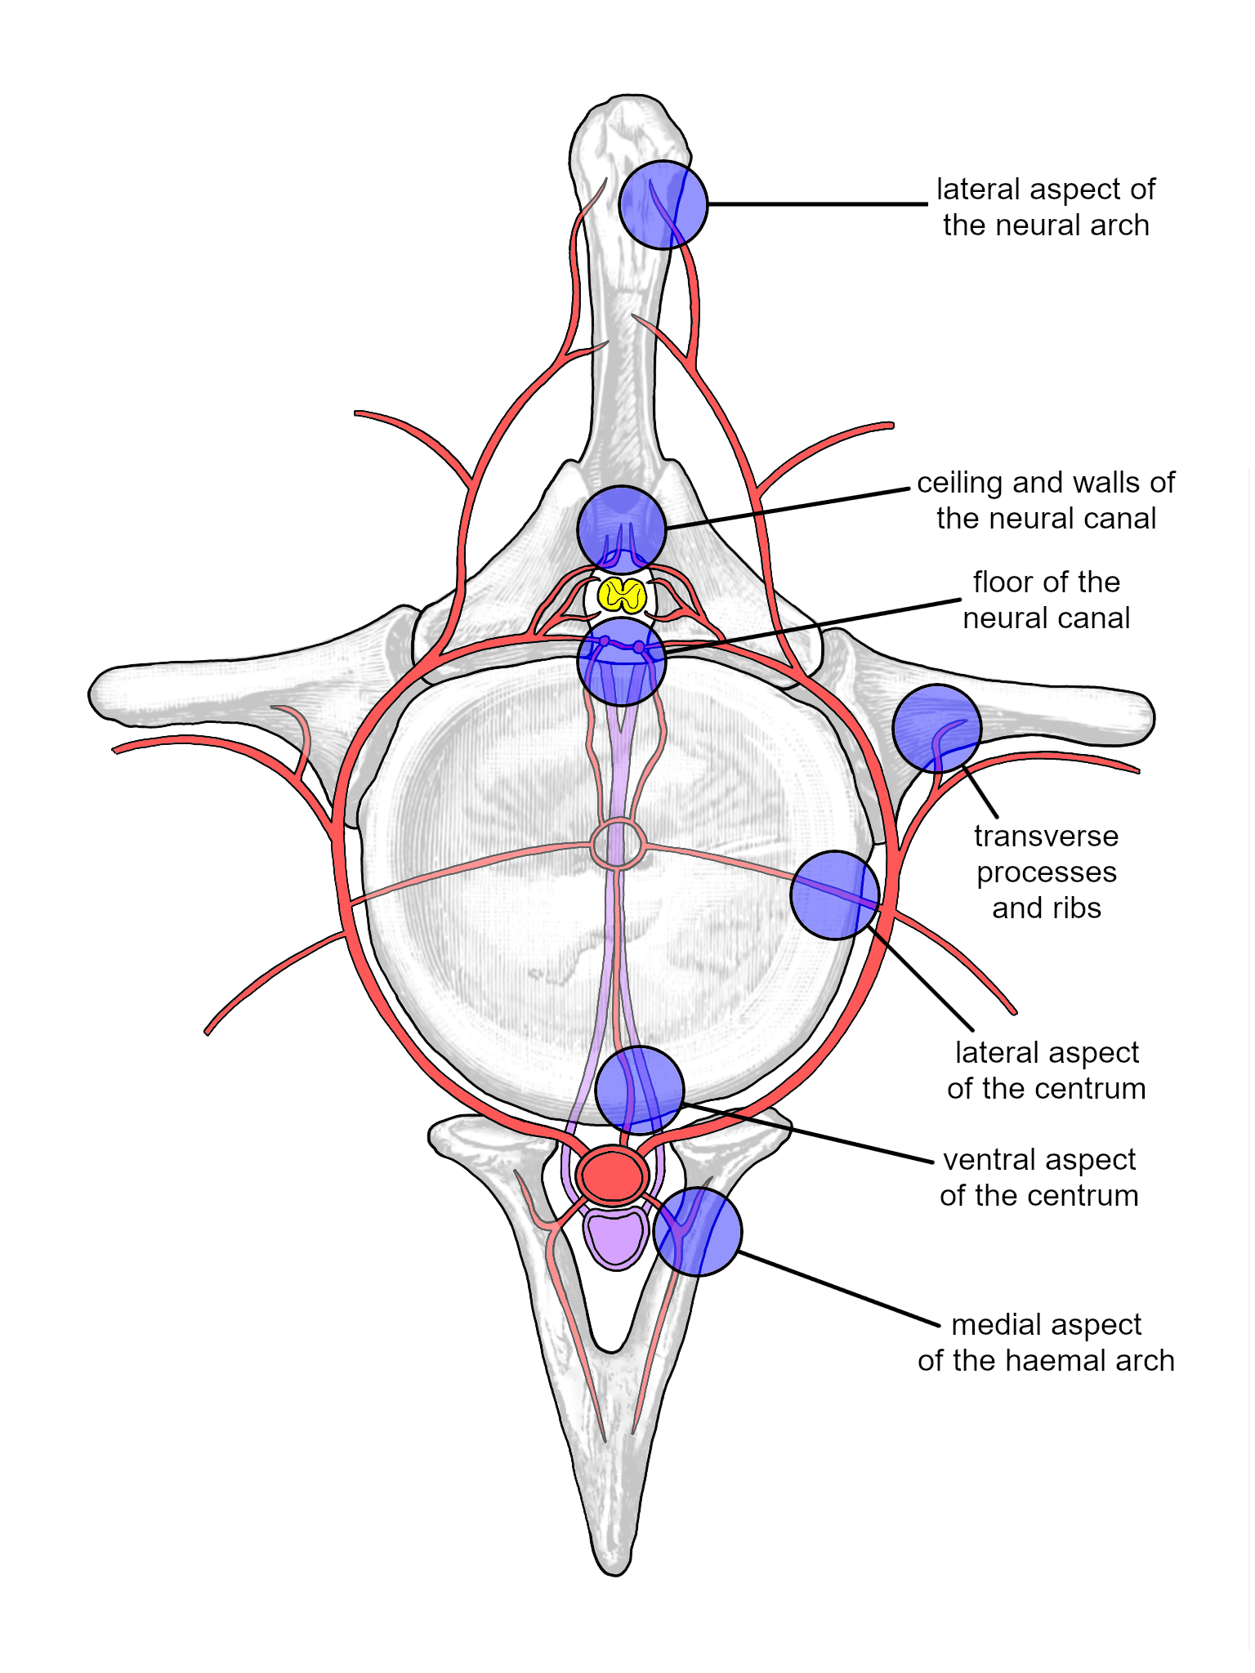
Pneumatization (air entering bone)
The seven sites where arteries and veins enter and exit the bones are also the sites (blue) where the vertebral elements may be pneumatized by diverticula of the respiratory system.

Slide 4
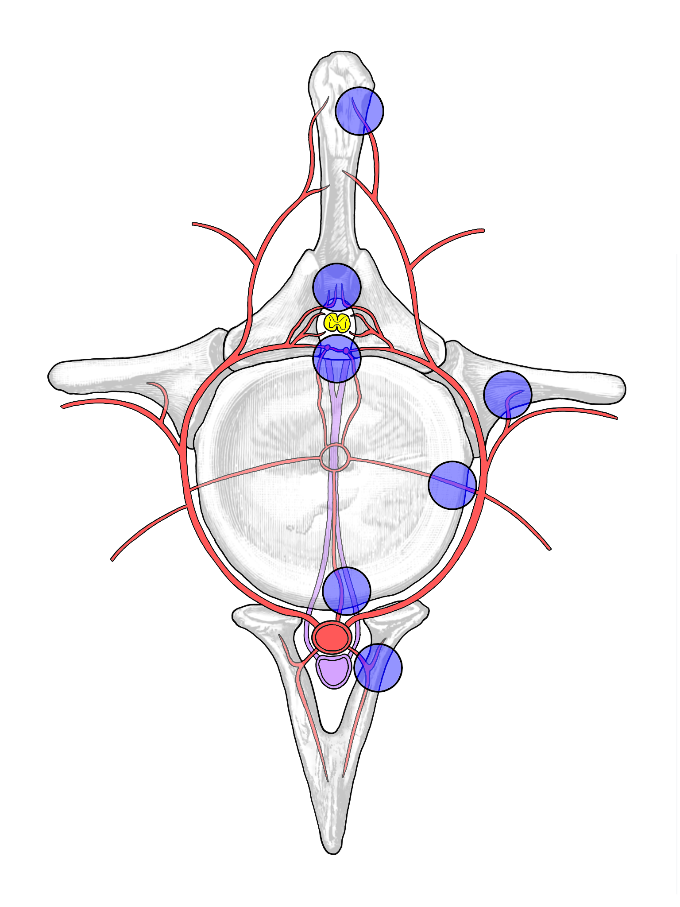
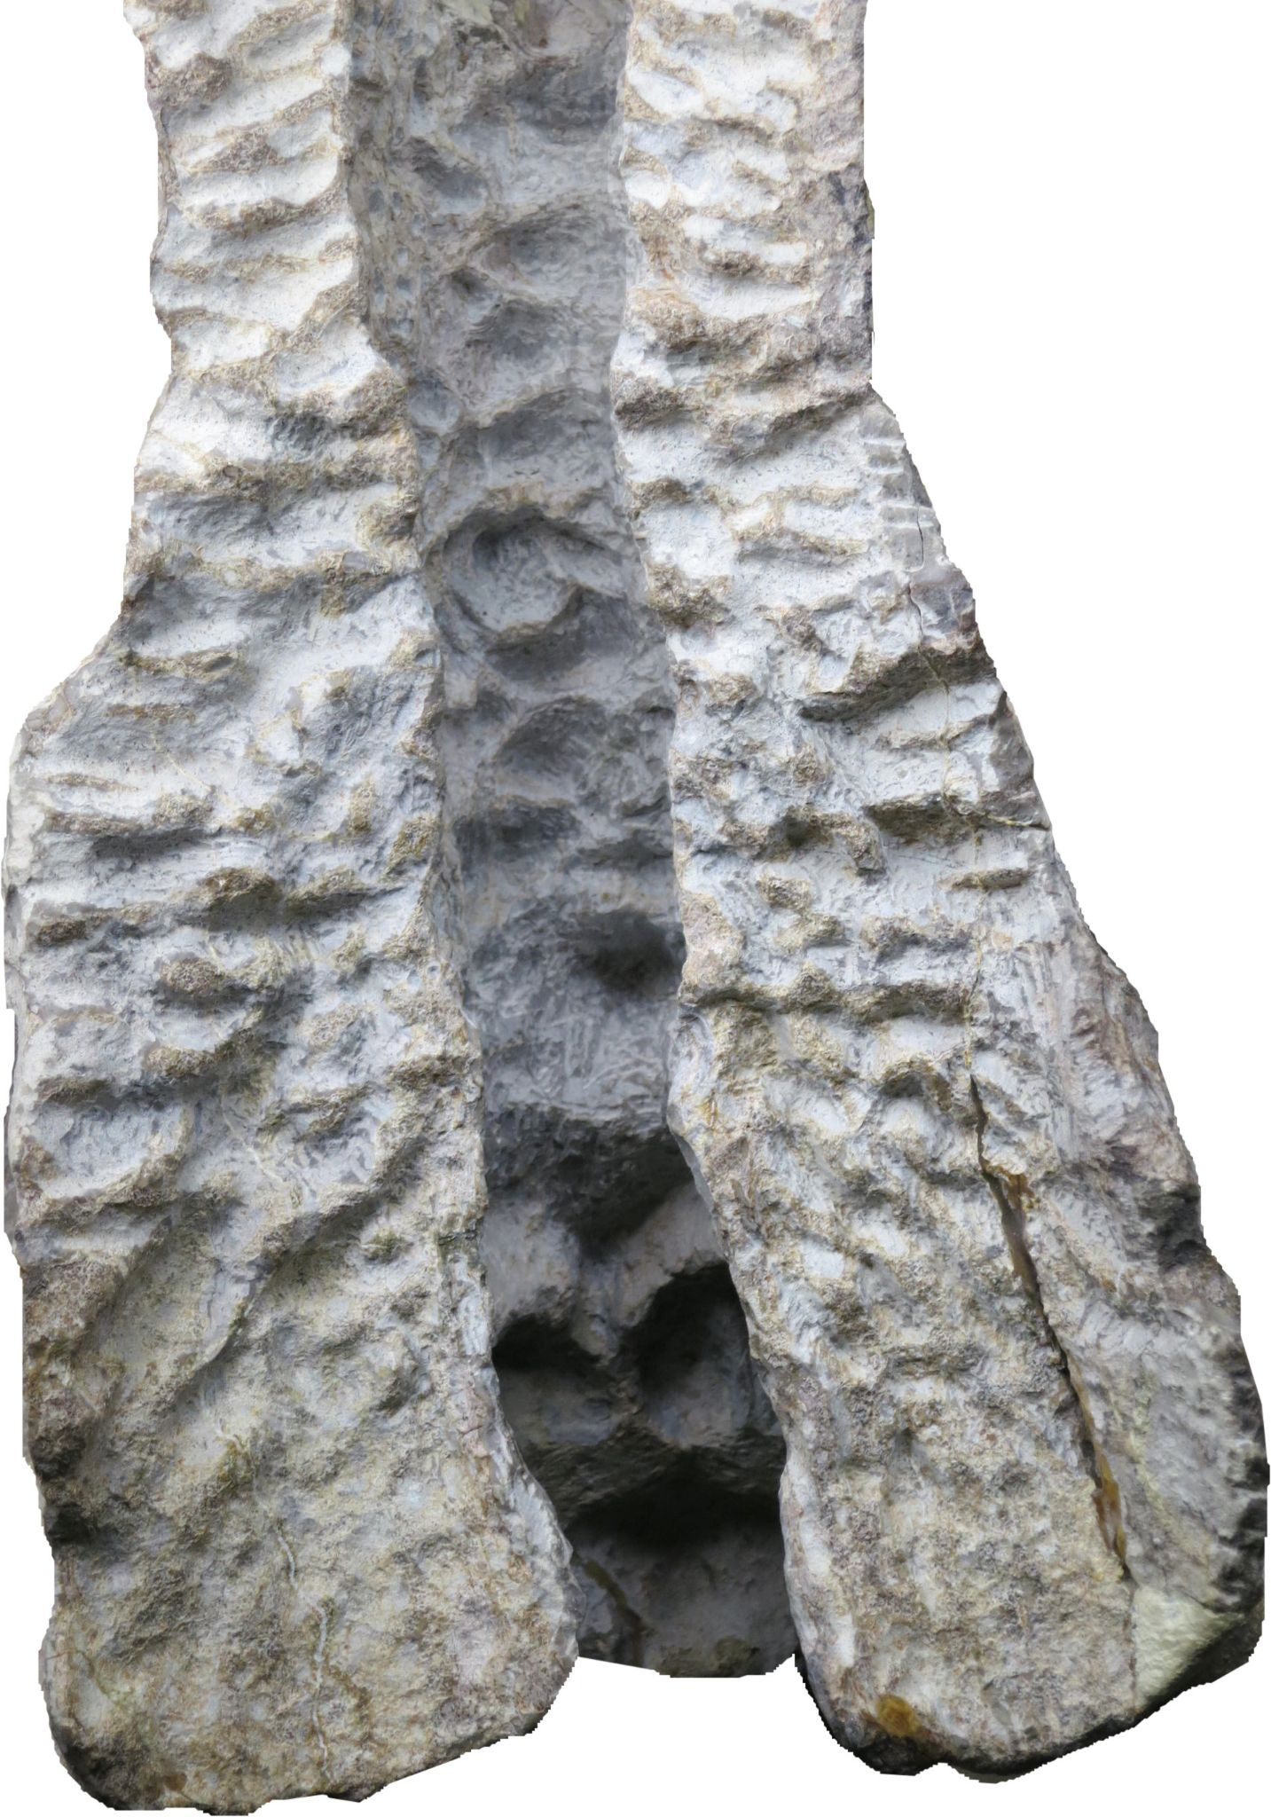
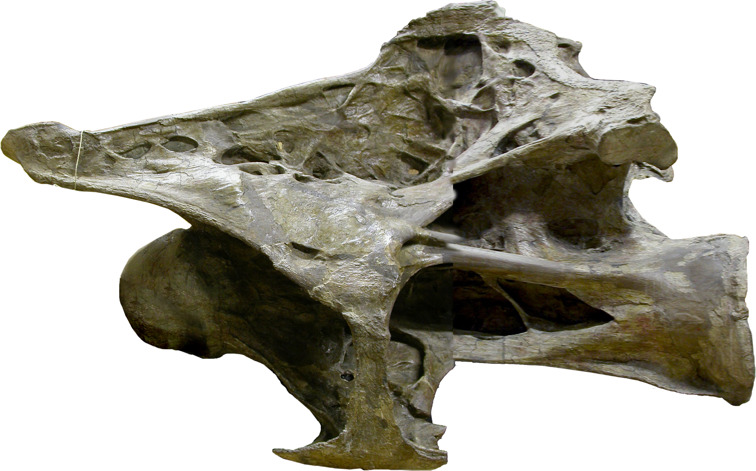
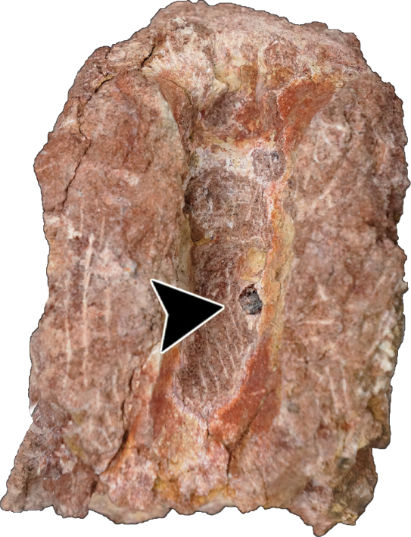
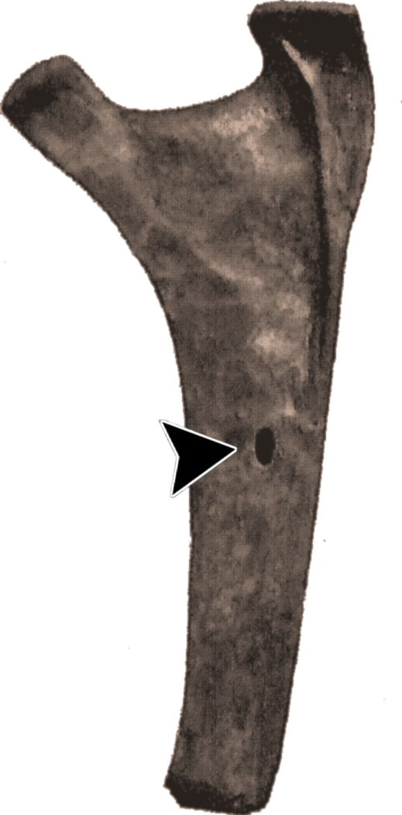
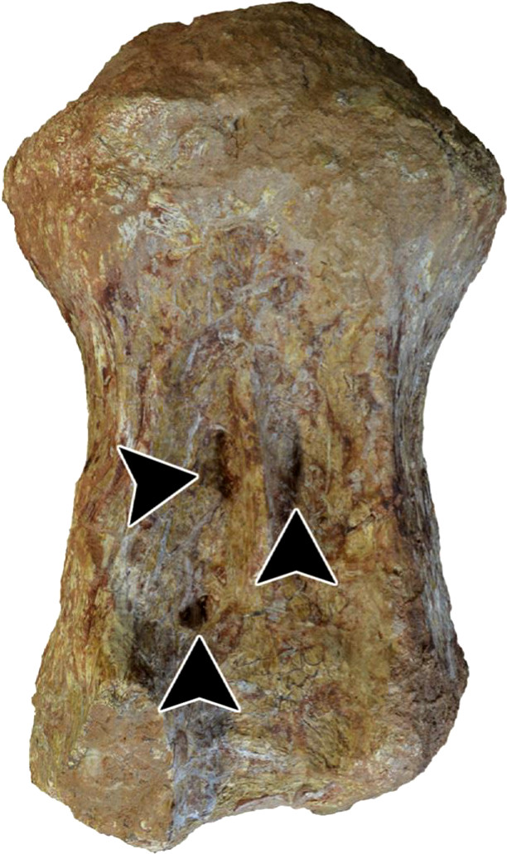
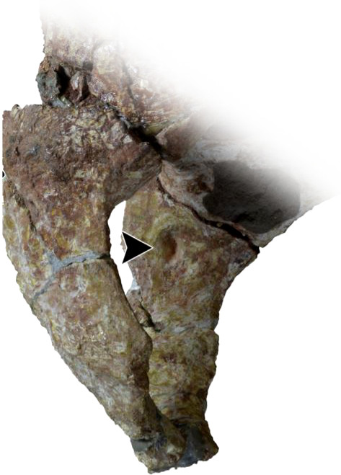
Examples of pneumatic fossae and foramina at sites of vascularization
See Atterholt & Wedel 2018 PeerJ Prep 6:e27201; Cerda et al 2012 Paläont Zeit 86: 441; Gorscak & O’Connor 2019 PLOS ONE e0211412; Lovelace et al 2008 Arq Mus Nac Rio de J 65: 527; Riggs 1904 Field Col Mus Geol Ser 2: 229; Schwarz & Fritsch 2006 Eclogae Geol Helvet 99: 65; Zurriaguz et al 2017 Cret Res 75: 101

Slide 5
Blood vessels provided the template for vertebral pneumatization in sauropod dinosaurs
Pneumatization of the vertebral column was a key innovation in the evolution of gigantism in sauropod dinosaurs. In extant birds, pneumatic diverticula of the lungs and air sacs follow nerves and blood vessels as they develop.
In extant amniotes, seven distinct groups of arteries and veins enter or exit the axial skeleton at distinctive locations: (1) lateral surface of the neural arch; (2) dorsal roof or lateral walls of the neural canal (neural arch elements); (3) ventral floor of the neural canal (centrum); (4) ventral surfaces of the transverse processes, or inner surfaces of the ribs; (5) lateral surfaces of the centrum; (6) ventral surface of the centrum; (7) medial surface of the haemal arch.
In the skeletons of sauropods, pneumatic fossae and foramina have been documented at all seven of these locations, although not all locations may be pneumatized in a single individual, or even across a clade. The close correspondence suggests that sites of vertebral pneumatization in sauropods follow conserved patterns of vertebral vasculature in amniotes.
(The same relationship of pneumatic features to blood vessels probably existed in non-avian theropods and pterosaurs, but has not yet been documented. Many of the sites of pneumatization are the same in those clades, however.)
Despite sauropods having attained masses an order of magnitude greater than other terrestrial animals, this is evidence that they were built just like other animals, rather than being special magical monsters. Axial pneumaticity gives us a window on the fact that, at the most basic level, sauropod skeletons developed much like those of extant amniotes.

